Slide 1
Summer Internship Report On
“LEAD SCORING CASE STUDY”
Using Machine Learning
Under the Supervision of
Ms.B.Shireesha
Assistant Professor
CSE DEpartment
RGUKT,Ongole
BY
BELLAMKONDA PUSHPA SHREE

Slide 2

CONTENTS
Internship Completition Certificate
Abstract
Introduction and Methodology
Hardware and Software Requirements
UML Diagrams
Output Screens
Conclusion

Slide 3

Internship Certificate

Slide 4
ABSTRACT
An education company named X Education sells online courses to industry professionals. On any given day, many professionals who are interested in the courses land on their website and browse for courses. The company markets its courses on several websites and search engines like Google. Once these people land on the website, they might browse the courses or fill up a form for the course or watch some videos. When these people fill up a form providing their email address or phone number, they are classified to be a lead. Moreover, the company also gets leads through past referrals. Once these leads are acquired, employees from the sales team start making calls, writing emails, etc. Through this process, some of the leads get converted while most do not. The typical lead conversion rate at X education is around 30%.

Slide 5
INTRODUCTION
Lead scoring is the process of using a pre-defined methodology to assign numerical values to leads that enter a sales pipeline to determine their sales-readiness. Leads receive points based on a range of demographic and behavioural characteristics. There are two types of lead scoring: explicit lead scoring and implicit lead scoring. Explicit lead scoring is based on the information that a lead tells you directly. For example, the size of their company, their job title, geographic location, age, gender, and company role. On the other hand, implicit lead scoring uses the information you conclude about the prospect when observing their behaviours. For example, how they interact with your website, engage with emails, etc

Slide 6
METHODOLOGY
Understanding the data set and data preparation
Apply Recursive Feature Elimination to identify the best
performing subset of features for building model
Building the model with features selected by RFE.Eleminate the
features with high p-value and VIF values and finalize the model
Perform the model evaluation with various matrix like
sensitivity, specificity, precision ,recall , etc

Slide 7
SOFTWARE REQUIREMENTS
HARDWARE REQUIREMENTS
Vs code
Memory: 4 GB RAM or above
Jupytor Notebook
Storage: 100GB or above
Python Programming Language

Slide 8
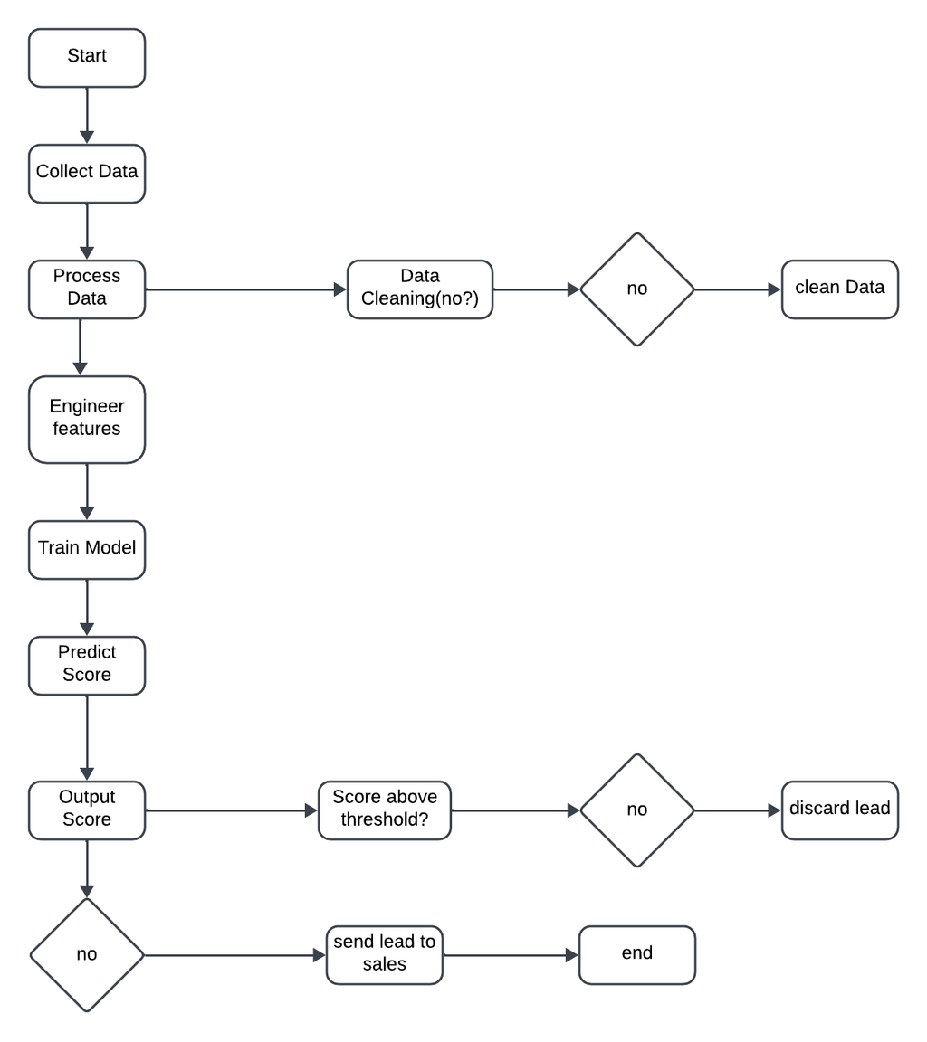
UML Diagrams
Activity Diagram

Slide 9
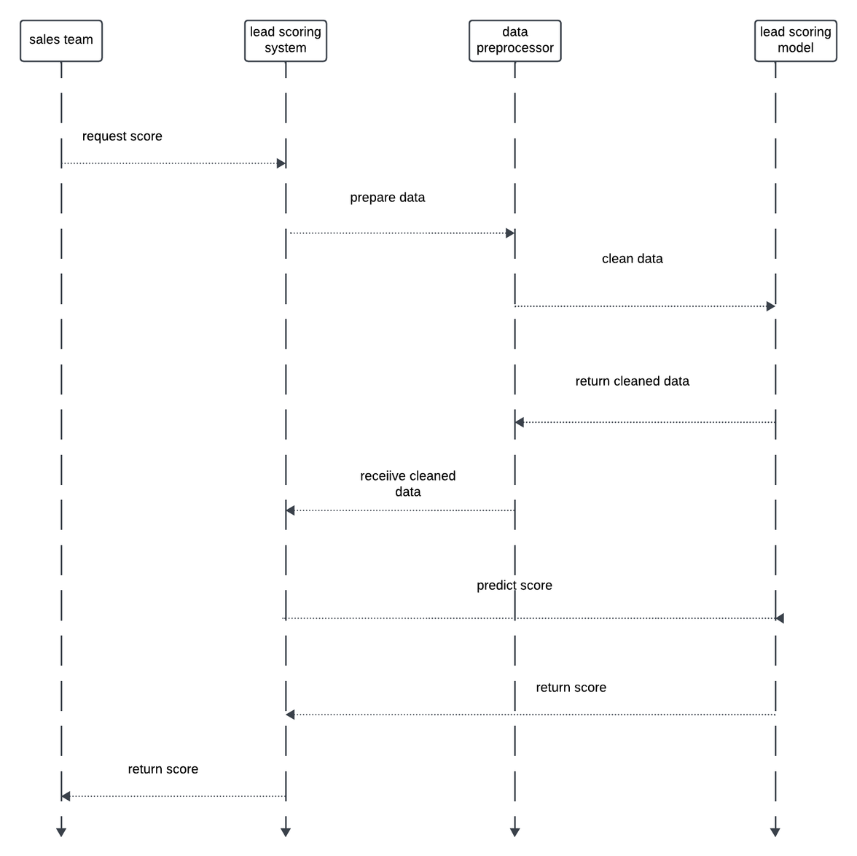
Sequence Diagram

Slide 10
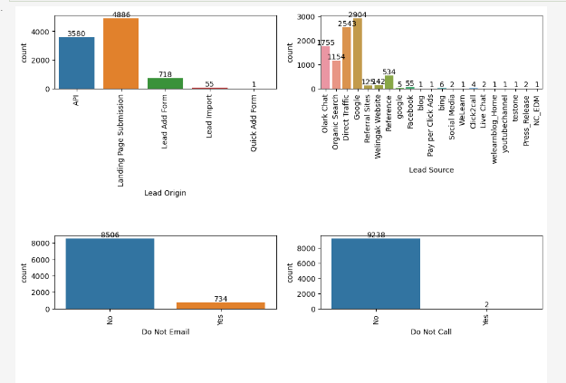
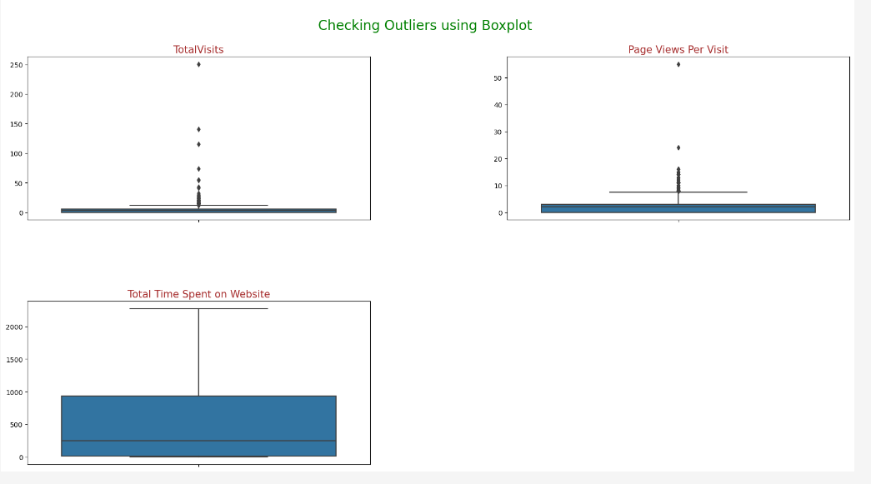
Outputs
-checking skewness in categorical columns using countplots

Slide 11
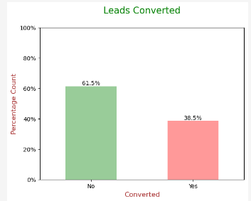
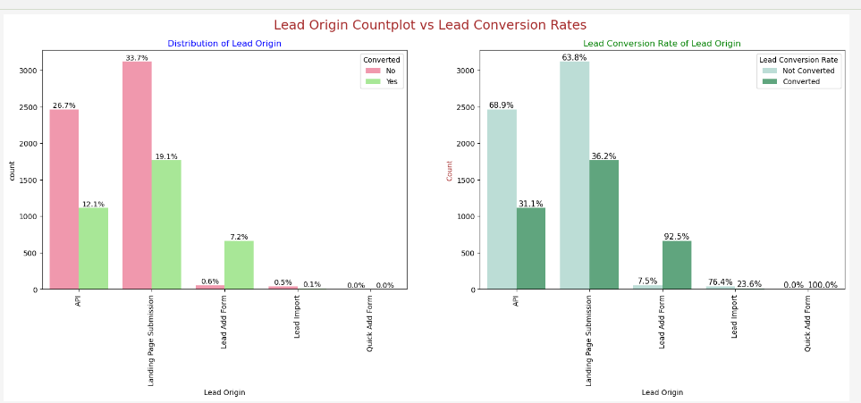

Slide 12
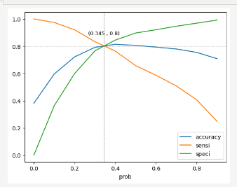
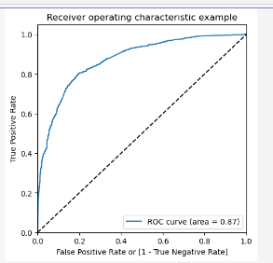
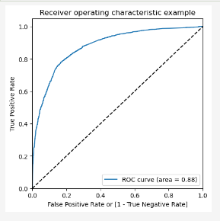
-ACCURACY ,SENSITIVITY,SPECIFICITY FOR VARIOUS PROBABILITIES
Test data
Train Data

Slide 13
Conclusion
TRAIN DATA SET
TEST DATA SET
ACCURACY:80.46%
ACCURACY:80.34%
SENSITIVITY:80.05%
SENSITIVITY: 79.82%
SPECIFICITY:80.71%
SPECIFICITY:80.68%
The model achieved a ‘sensitivity of 80.05% in the train set and 79.82% in the test set using a cutoff value of 0.345
The SENSITIVITY in this case indicates how many leads the model identify correctly out of all potential leads which are converting .

Slide 14
Thank you

